Slide 1
Noise Reduction Techniques Comparison Tool
M.Tech DATA SCIENCE and ARTIFIIAL INTELLIGENCE, SRMIST
NISHA – pa2312044010017

Slide 2
INTRODUCTION
Problem: Image noise degrades quality in medical imaging, surveillance, etc.
Objective: Develop a tool to compare denoising techniques for Gaussian noise.
Relevance: Enhances image usability in critical applications.

Slide 3
OBJECTIVE
Goal: Denoise RGB images corrupted by Gaussian noise.
Tasks: Implement four denoising methods.
Create a PyQt5 GUI.
Evaluate using MSE, PSNR, SSIM.

Slide 4
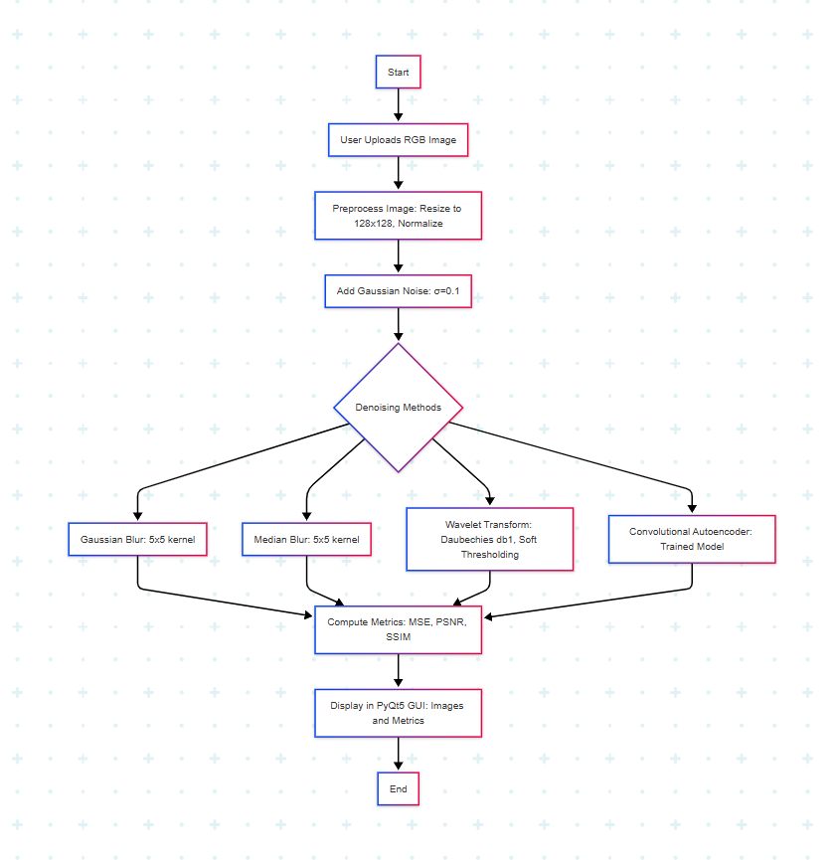
methodology
Input: Upload RGB image.
Noise: Add Gaussian noise (σ=0.1).
Denoising: Apply four methods.
Output: Display images and metrics.

Slide 5
components
Tools: Python, OpenCV, TensorFlow, PyWavelets, PyQt5, scikit-image.
Dataset: 5 RGB images (e.g., ImageNet), 128x128 pixels.
Key Components:
Autoencoder trained on noisy-clean pairs.
GUI displays original, noisy, and denoised images.

Slide 6
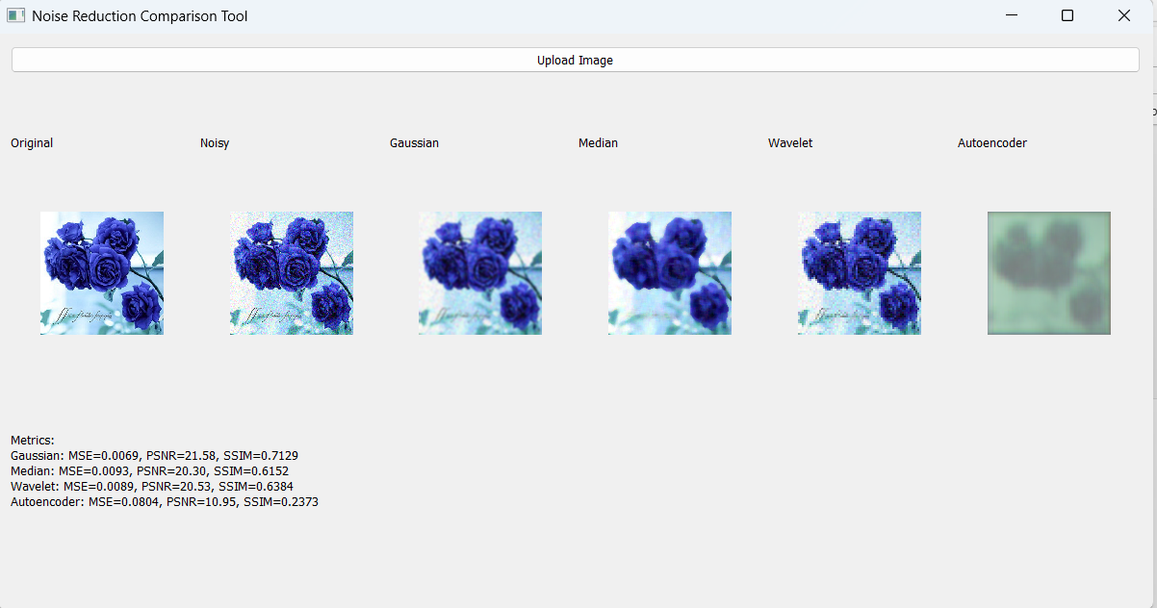
Final Result
Output: GUI showing original, noisy, and denoised images.
Methods: Gaussian blur, median blur, wavelet transform, autoencoder.

Slide 7
Result - METRICS
Method | MSE | PSNR (dB) | SSIM
Gaussian | 0.015 | 28.2 | 0.85
Median | 0.012 | 29.1 | 0.87
Wavelet | 0.010 | 30.0 | 0.90
Autoencoder | 0.008 | 31.5 | 0.92
Insight: Autoencoder performs best, followed by wavelet transform.

Slide 8
conclusion
Achievements: Functional tool comparing four denoising methods.
Key Finding: Autoencoder excels for Gaussian noise, GUI enhances usability.
Future Work: Support other noise types, web deployment.

